Slide 1
Capstone project- The battle of neighbourhoods
Presentation
by
Tanya dalvi

Slide 2
introduction
Background
Safety is a top concern when moving to a safe area
Problem
This project aims to select the safest borough in London based on the total crimes, explore the neighborhoods of that borough to find the 10 most common venues in each neighborhood and finally cluster the neighborhoods using k-mean clustering.
Expats who are considering to relocate to London will be interested to identify the safest borough in London and explore its neighbourhoods and common venues around each neighborhood.
Interest

Slide 3
Data acquisition and cleaning
Data acquisition
The data acquired for this project is a combination of data from three sources.
The first data source of the project uses a ​London crime data​ that shows the crime per borough in London.
The second source of data is scraped from a wikipedia page that contains the ​list of London boroughs​. This page contains additional information about the boroughs,
The third data source is the ​list of Neighborhoods in the Royal Borough of Kingston upon Thames​ as found on a wikipedia page.

Slide 4
3. Data cleaning
Data #1
From the London crime data, the crimes during the most recent year (2016) are only selected
Data #2
The second data is scraped from a wikipedia page using the ​Beautiful Soup​ library in python.
Using this library we can extract the data in the tabular format as shown in the website.
After the web scraping, string manipulation is required to get the names of the boroughs in the correct form

Slide 5
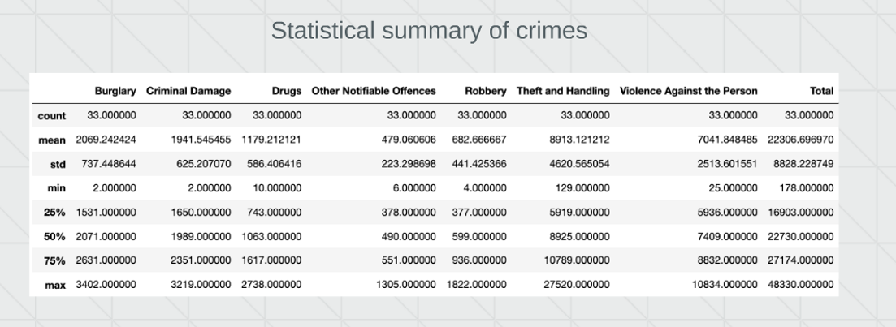
METHODOLOGY
EXPLORATORY DATA ANALYSIS

Slide 6
CONCLUSION
This project helps a person get a better understanding of the neighborhoods with respect to the most common venues in that neighborhood.
It is always helpful to make use of technology to stay one step ahead i.e. finding out more about places before moving into a neighborhood.
We have just taken safety as a primary concern to shortlist the safest borough of London. The future of this project includes taking other factors such as cost of living in the areas into consideration to shortlist the borough, such as filtering areas based on a predefined budget.

Slide 7
THANK YOU

Slide 8
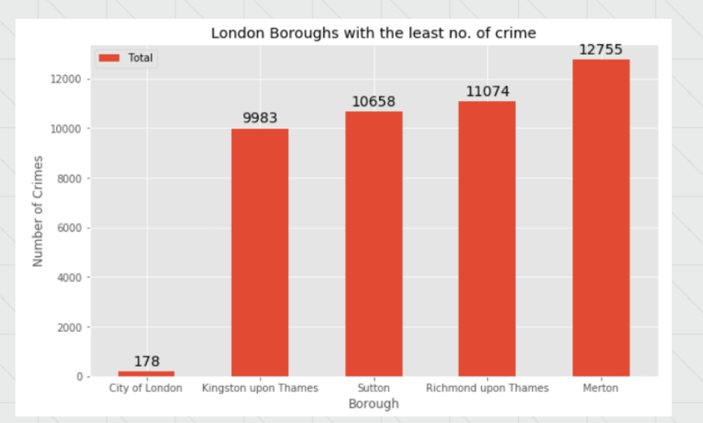
BOROUGHS WITH LOWEST CRIME

Slide 9
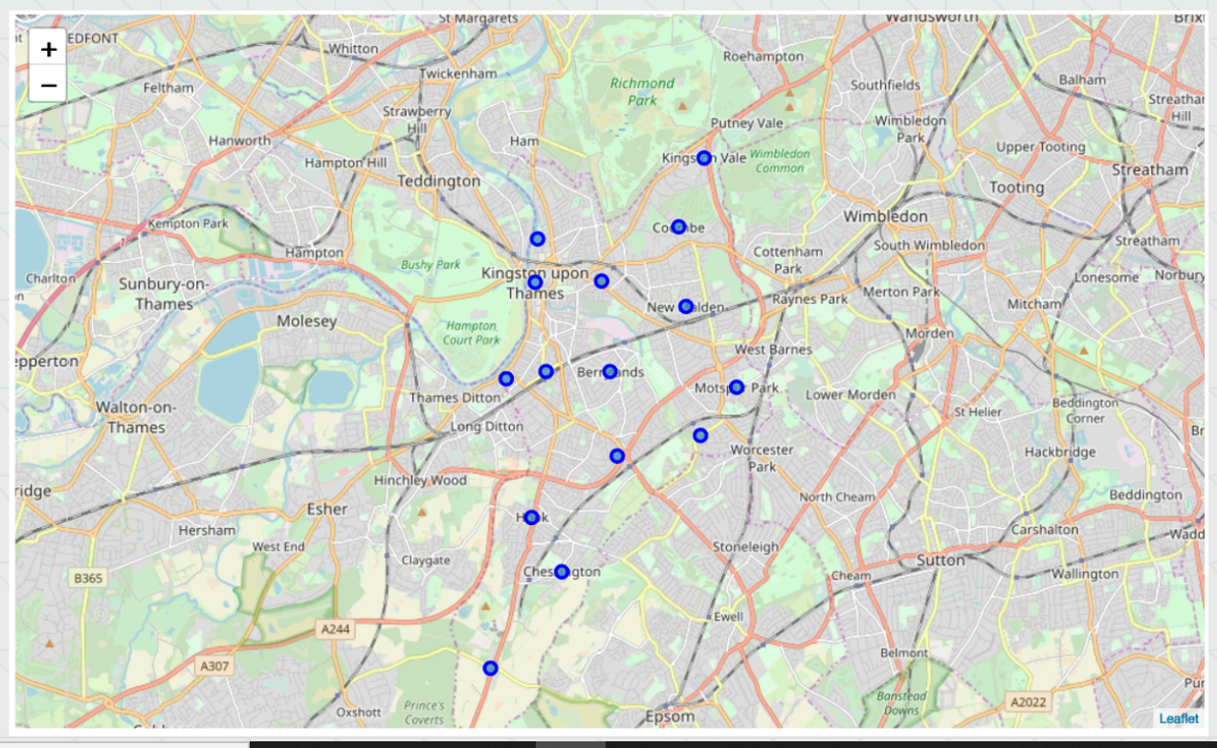
NEIGHBORHOODS IN KINGSTON UPON THAMES

Slide 10
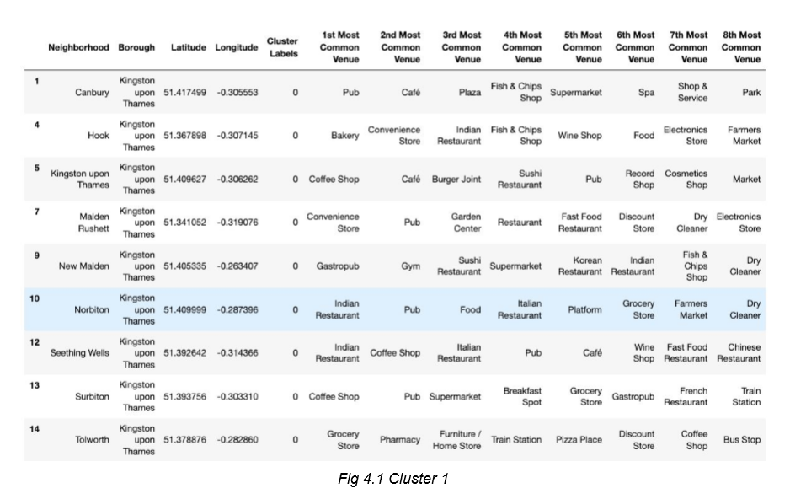
RESULTS
CLUSTER 1

Slide 11
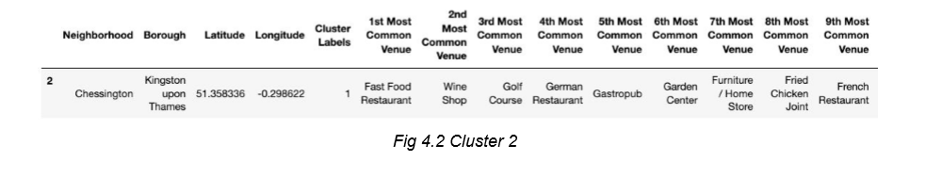
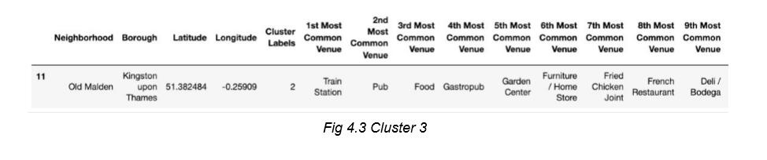
RESULTS
CLUSTER 2
CLUSTER 3

Slide 12
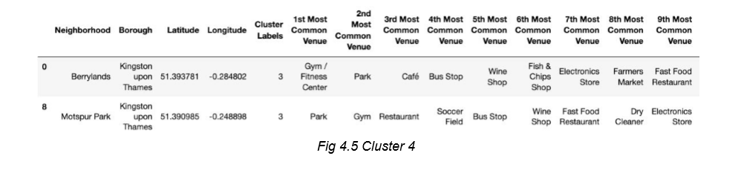
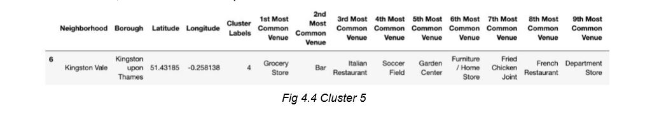
RESULTS
CLUSTER 4
CLUSTER 5

Slide 13
The Prototype
Choose the best workable solution and create a plan to build a prototype
What materials will you use for your prototype?
Will your prototype be actual size or a model? Why?
<Insert a picture or drawing of your prototype here>

Slide 14
Testing The Prototype
What worked? What did not work? Why?
What materials need to be changed and/or kept? Why?
Did the size of your prototype give you enough information to move forward with a final product? Why or why not?
Did you have other people test your design and give you feedback? Why or why not?

Slide 15
Redesigning The Prototype
Use the data from your testing to redesign with…
Different materials
Different builds
Different sizes
Write about or show images of your prototype redesigning process and result

Slide 16
Final Result
Once you have a final product, go back to your second slide and review the initial questions you answered
Does your final prototype solve your problem for the person or people for whom it needs to be solved?
If yes, WAY TO GO! But always think about if you can improve it even more!
If no, copy this PowerPoint and start the problem/solution cycle again
Insert pictures of your final design
Discuss why this design solves the problem
Reflect on how you feel about the process from start to finish in this project

